Slide 1
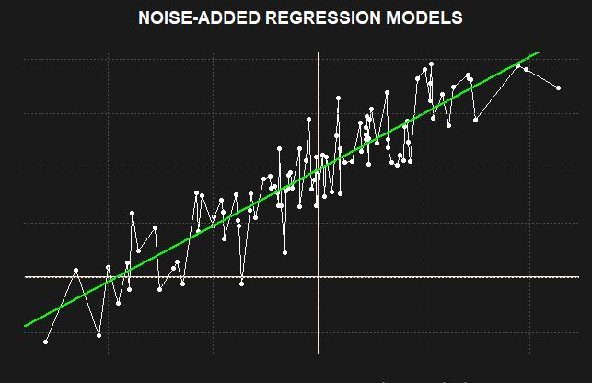
NOISE-ADDED REGRESSION MODELS
Stanley Sayianka

Slide 2
THEME
The theme of the product development and design competition is Actuarializing the world with Sustainable Development Goals, and some of them include:
- Decent Work and Economic Growth: Creating jobs for all to improve living standards, providing sustainable economic growth.
- Industry, Innovation and Infrastructure: Generating employment and income through innovation.
- Reduced Inequalities: Reducing income and other inequalities, within and between countries.

Slide 3
Solving problems Actuaries are majorly involved in the SGDs, especially in regard to improving living conditions of people and businesses. An example of a problem solving framework which is most common is as follows: Formulation of a theory Collecting data relevant to the theory at hand Formulation of a mathematical model Solving the model appropriately e.g. linear models-regression.

Slide 4
Solving problems Some of the problems in line wit the SGDs could include, determining the life expectancy in a given country, determining suicide rates in a particular population and factors affecting them, e.t.c determining cancer mortality rates and factors accelerating such
FORMULATION OF A THEORY e.g. an actuary could say “I BELIEVE, THAT SUICIDE RATES IN THIS POPULATION ARE CAUSED MAJORLY BY THE LIVING STANDARDS, LEVEL OF EDUCATION, AGE e.t.c
COLLECTING DATA RELEVANT TO THEORY
e.g. collecting data from past regarding monthly suicide rates in a particular region, age of the deceased, level of education e.t.c
FORMULATION OF A MATHEMATICAL MODEL
coming up with a model e.g. Suicide rates = Fn (EDUCATION, AGE, GDP.capita, UNEMPLOYMENT )
SOLVING THE MODEL APPROPRIATELY
Most of the mathematical models which actuaries deal with are linear models, thus solvable using regression

Slide 5
Since actuaries and actuarial work is regarded as one of the most data driven roles, actuaries rely on data, analytics and information acquired from statistical models to inform their decisions which are in turn tied directly to the performance and well-being of businesses, industries, lives of people and finances.
Thus improving on the work of these statistical models actually leads to improved decision making by the actuaries, and this may in turn lead to improved solving of general problems involving the financial security of people, companies, and governmental organizations

Slide 6
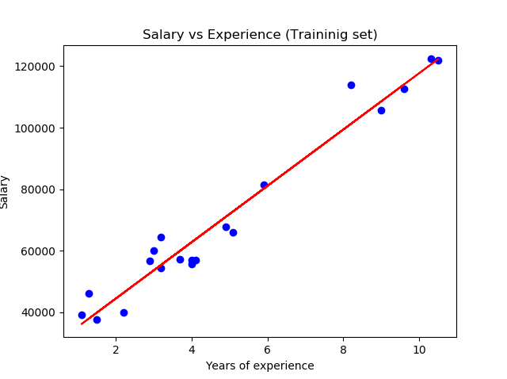
Introduction
Regression models are one of the most widely used models in actuarial work in the context of predictive analytics, since despite their simplicity, their performance competes with some of the most complex models available in modelling literature.
At its simplest form, the core of regression models is to seek for a linear relationship between a dependent variable (often called the response variable) and an independent variable, also known as the predictor variable.

Slide 7
Applications of Regression models in Actuarial work
Regression models find a lot of application in actuarial work, ranging from:
-Forecasting and financial analysis, e.g. in CAPM, financial forecasting.
-Pricing and adverse selection. - Regression can be used to identify the variables that are important determinants of expected claims.
-Reserving and solvency testing - Predicting whether liabilities associated with a group of policies will exceed the capital devoted to meeting obligations arising from the policies.
-In sales e.g. of insurance products and policies regression can be used in determining the volume of sales based on advertisements.
- In time series analysis, regression models are also used widely.
-In data imputation, regression models are also used.
-Fitting loss distributions …..
and much more

Slide 8
Interpretations
Regression models can have diverse interpretations and inference, but as of now I would focus on the following:
A regression model can be viewed in terms of the total variation in the response variable that is explained by the model, and that which is unexplained by the model. It would be desirable that the amount of variability explained by the model is much higher, and that which is unexplained is much lower.
The aim of this research and project paper is to improve the linear regression models predictive performance, based on incorporating the unexplained variation in its predictive component, using the nearest neighbor algorithm, thus the term “noise-added”.
Notes:
Speak about R squared metric, residual standard error.

Slide 9
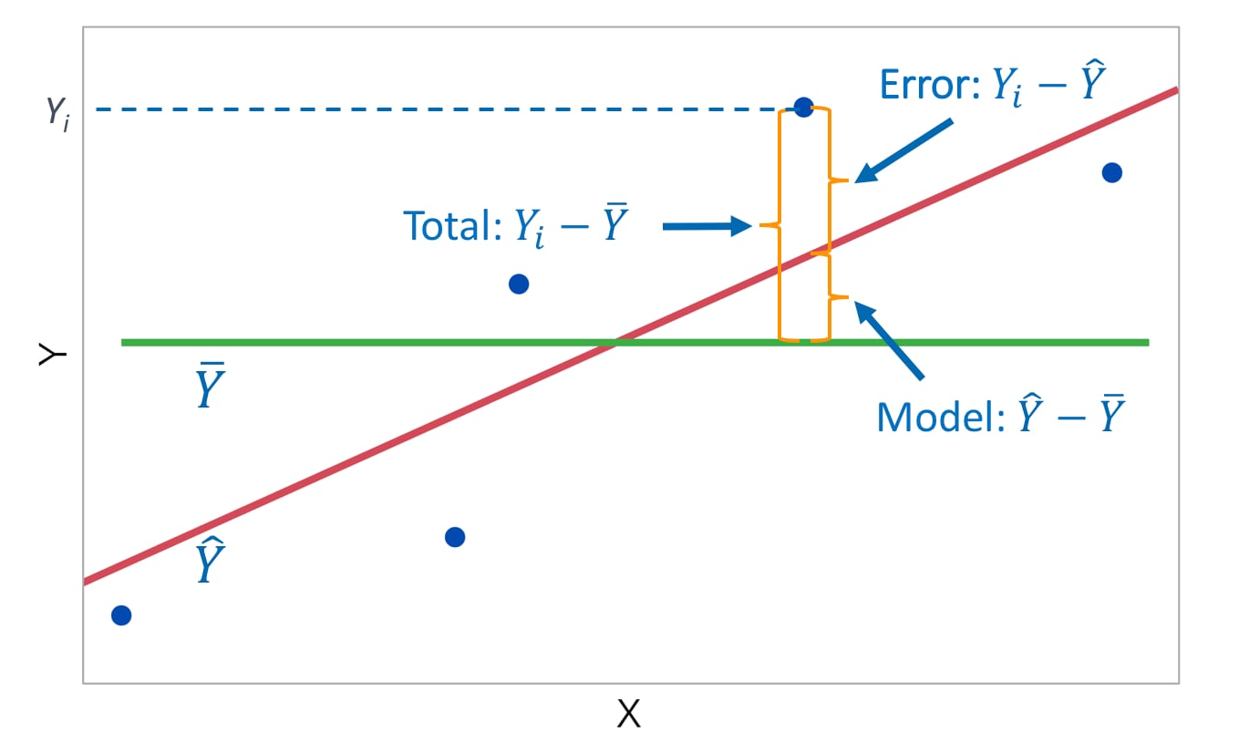
Variability Explained and Unexplained by the model
error
error

Slide 10
Variability Explained and Unexplained by the model
TOTAL Variability
In our data
EXPLAINED Variability
By the model
UNEXPLAINED Variability
?
=
+

Slide 11
Nearest Neighbor Algorithm
The nearest neighbor algorithm is an important algorithm specifically in classification tasks, which seeks to associate a particular data point as being of a particular class or cluster based on its distance to its closest data point.
That is, the algorithm starts by computing distances between a single point(whose class is unknown) and all the other points in a training set, the based on a specific chosen parameter k (the number of neighbors), a vote is taken, and the data point is the associated with the class or cluster that won the vote.

Slide 12
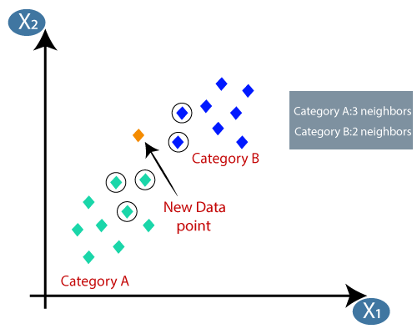
Nearest Neighbor Algorithm – In work
An example is in Auto insurance, we could be tasked with developing a model to determine if a customer will submit a vehicle insurance claim: We could use the following:
Number of policies
Length of the policy
Vehicle make
City of operation … and more

Slide 13
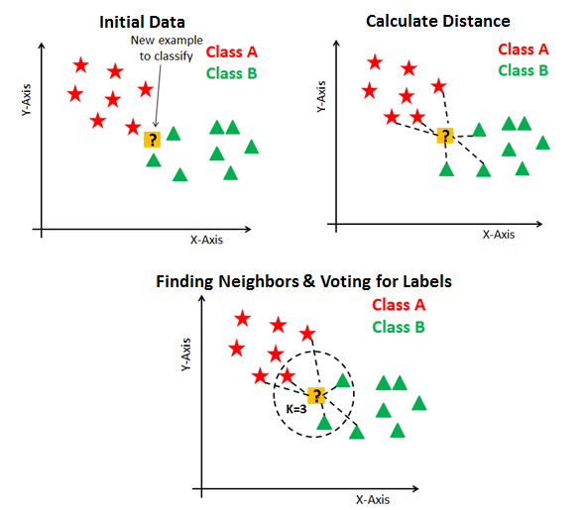
Then we could use the Nearest Neighbor search to determine if a particular customer will submit a claim
As shown ….

Slide 14
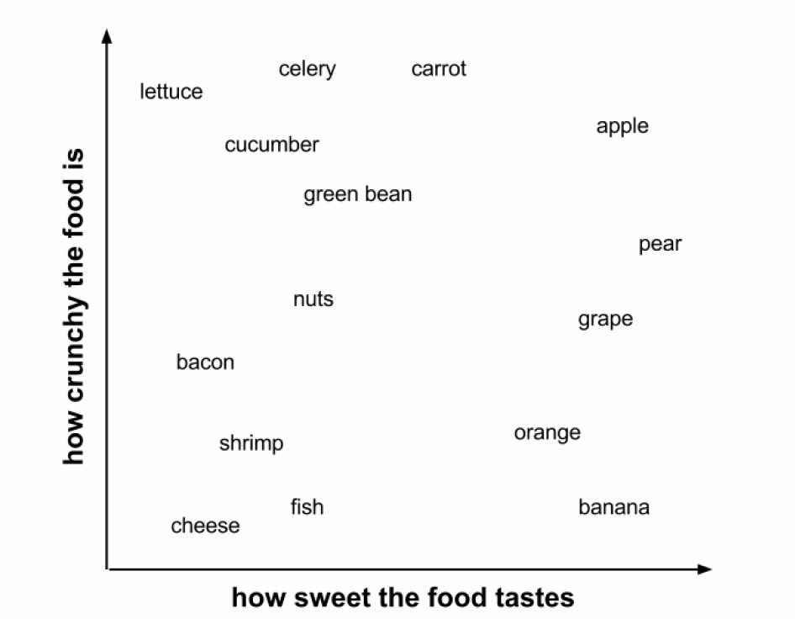
Tomato, a fruit or a vegetable ?

Slide 15
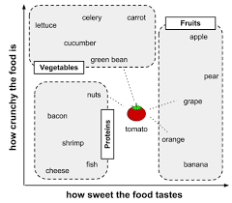
Among the four closest neighbors of the tomato,
They include: grapes, oranges, nuts, green beans.
-Two of them are fruits
-One is a protein
-One is a vegetable.
Since two are fruits, then we conclude and say a tomato also is a fruit.

Slide 16
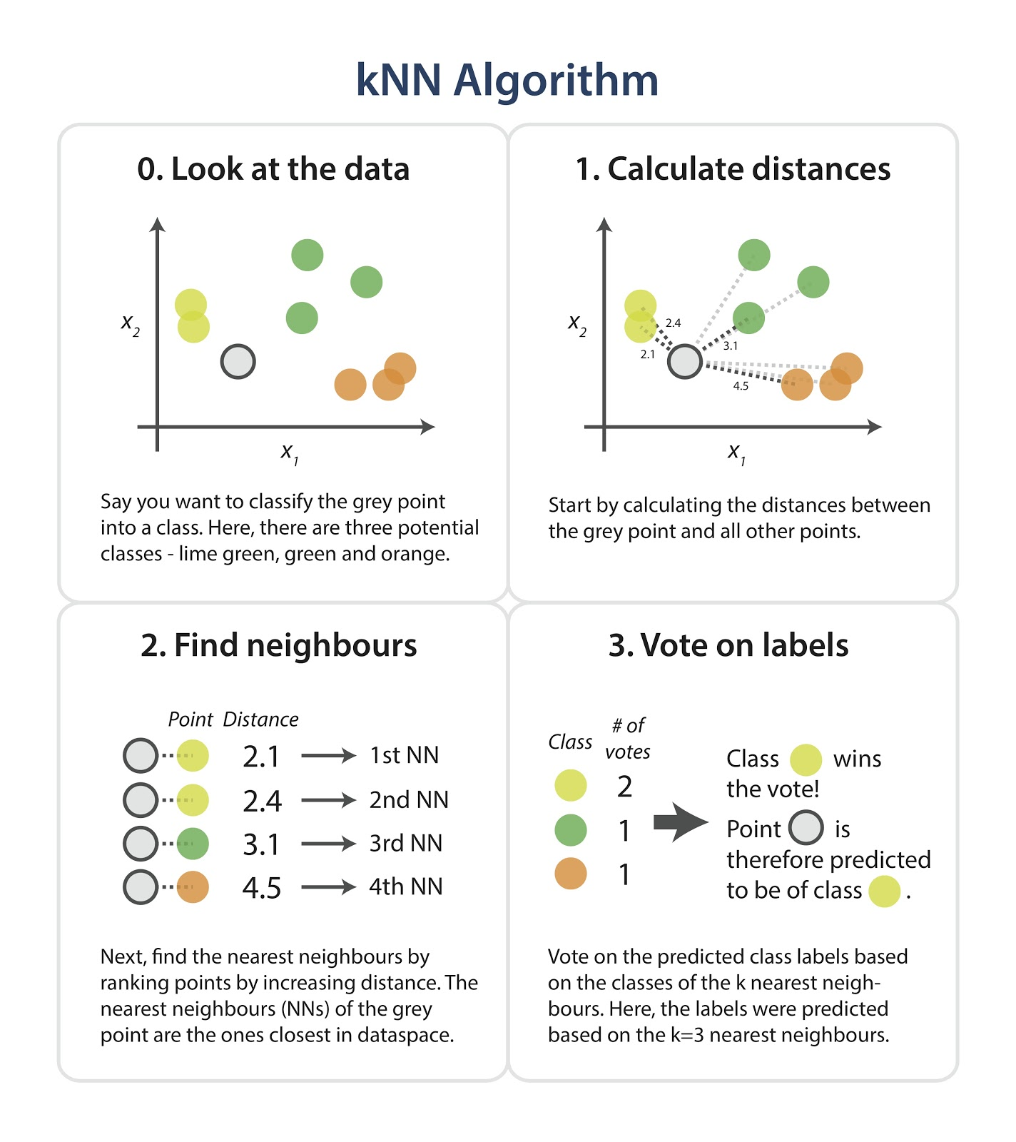

Slide 17
Combining the Two algorithms
In this, we seek to improve the performance of the predictive regression models by using the nearest neighbor approach, such that, we have training data which is used to build the regression model, then for each new observation in a test dataset (unseen data), the regression model is used to predict the response variables, and then the nearest neighbor algorithm calculates the nearest neighbors of each particular data observation of the test dataset from among all the data points in the training set (say k neighbors), then once the nearest neighbors have been identified, the residuals (noise terms) of those nearest neighbors are averaged, and that result is added to the predicted response of the test set data point.

Slide 18
The intuition behind this “noise-added” model is that, since in many cases there always exists a substantial amount of residual sum of squares (that is: amount of variation unexplaind by the model), then the task of the regression model in a predictive sense is to explain the response variable in terms of the predictor variables, and the task of the nearest neighbor algorithm is to compensate for the unexplained variation in the response variable by the regression model, so in a way, all the variability is explained, that is:
Regression model – Accounts for the Regression sum of squares (Explained variability)
Nearest neighbor algorithm – Accounts for the Residual sum of squares. (Unexplained variability)

Slide 19
Head to Step by step noise adding

Slide 20
Experimental analysis
& Distribution of Added noise.

Slide 21
Conclusion
Since it is evident that the noise adding leads to improvement in the predictive sense of the regression models, then it is valuable that they should be preferred in actuarial work which places an importance on accuracy of predictions.
It is also noteworthy that the noise adding does not increase any complexity in the nature of simple and multiple linear regression model, rather the parsimony of the regression model is not tampered with since the noise added is in fact extracted from the regression model itself and not from an outward source.
Also the noise added models do not lead to an increased number of parameters to be estimated, rather inference is only based on the pure regression model thus preserving the simplicity and assumptions of the regression model. It is also noteworthy that the noise added regression model thrive both when the size of the data is small (i.e. fewer data points for analysis), as well as for the case of big data.
Thus this model may be incorporated into actuarial works involving regression analysis in a predictive sense

Slide 22
Future Extensions an experimentation
The concept of noise adding could also be incorporated into Generalized linear models (GLMs) such as Poisson regression models and Binomial (Logistic) regression models, which are also widely used in actuarial work.
0716573741

Slide 23
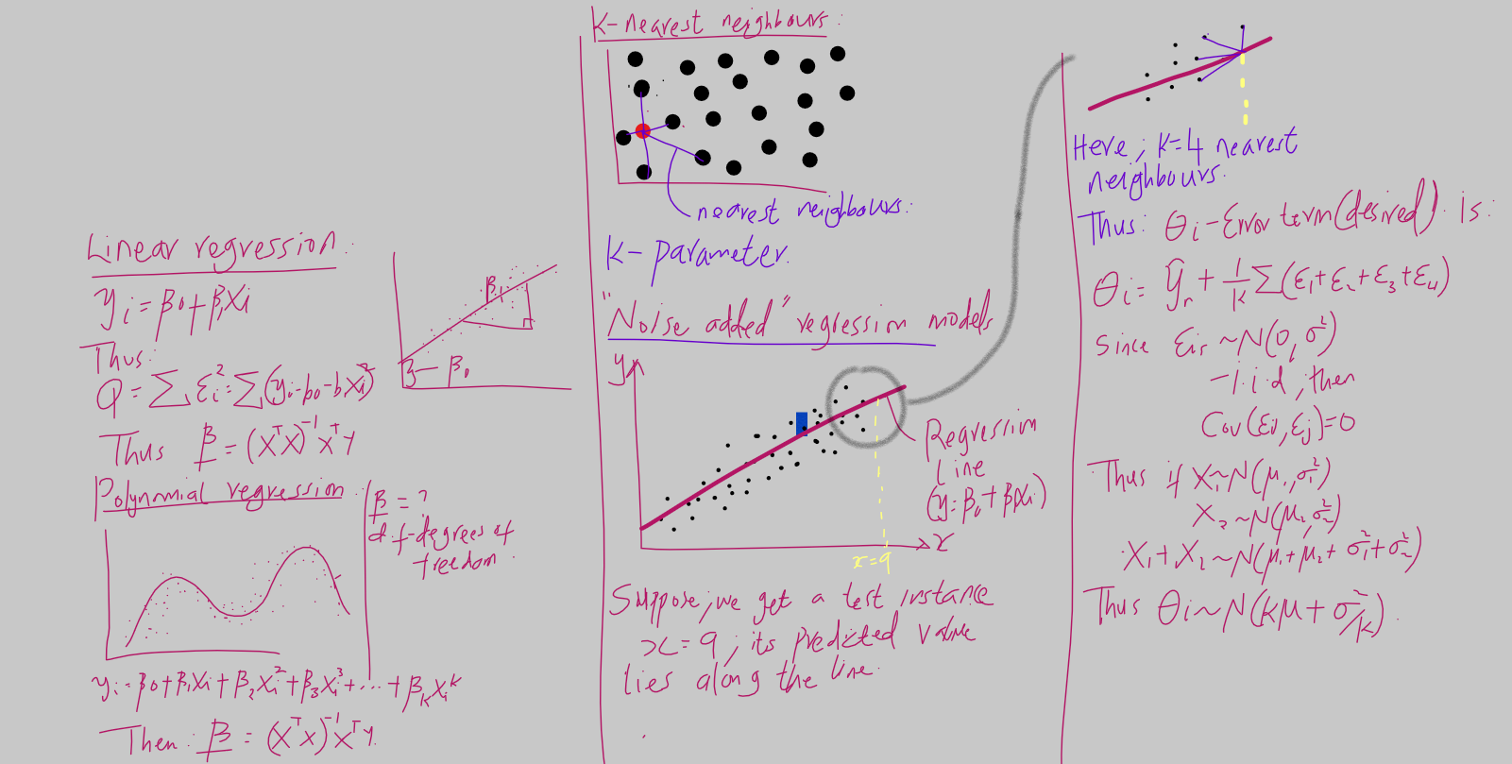
THE END

